Slide 1
HCI 557 Computer Graphics and Geometric Modeling
Homework 4 Presentation
BY
Michael Hoefer, Yuanfen Chen, Hsiang Sing Naik

Slide 2
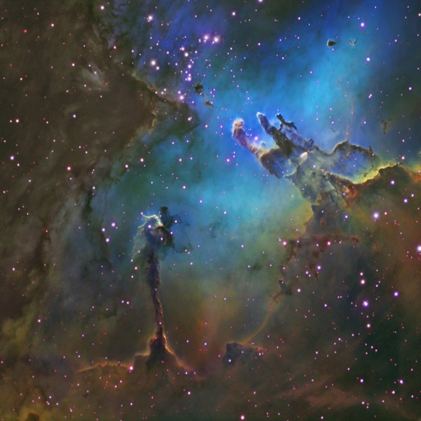

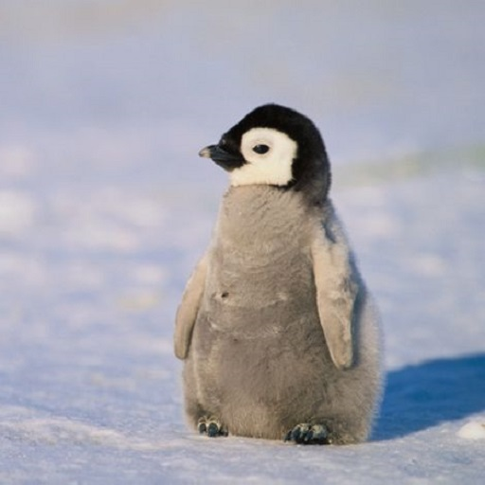
Problem 1
Eagle Nebula (Landscape)
Color Gradient
Penguin (Animal)

Slide 3
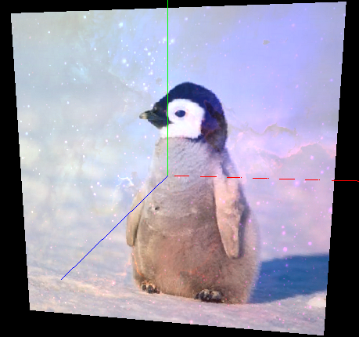
Trial 1
color = (gradient*0.5)*landscape + penguin;

Slide 4
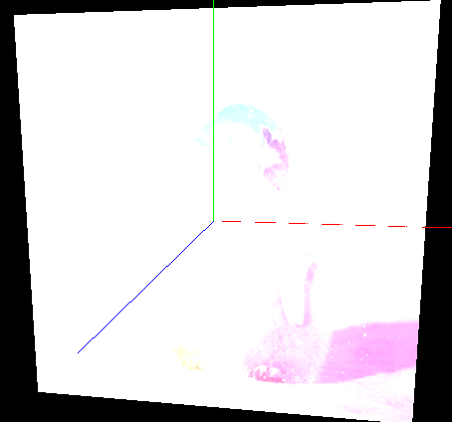
Trial 2
color = 0.1 * pass_Color + tex_gradient + tex_landscape + tex_penguin;

Slide 5
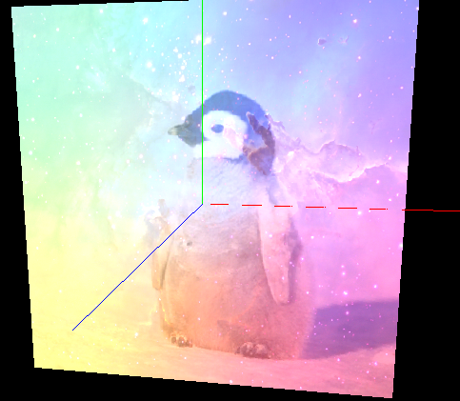
Trial 3
color = 0.1 * pass_Color + 0.5*tex_gradient+0.5*tex_landscape +0.5*tex_penguin;

Slide 6
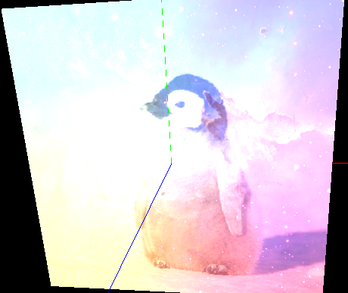
Trial 4
color = 0.1 * pass_Color + 0.5*tex_gradient+0.6*tex_landscape +0.7*tex_penguin;

Slide 7
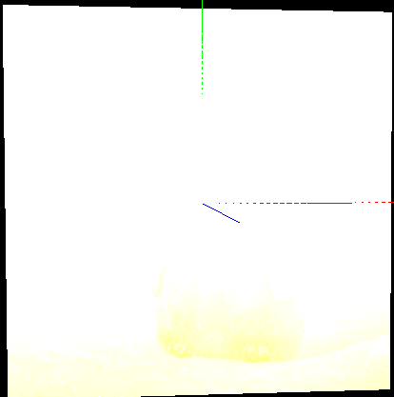
Trial 5
color = pass_Color + 0.5*tex_gradient+0.6*tex_landscape +0.7*tex_penguin;

Slide 8
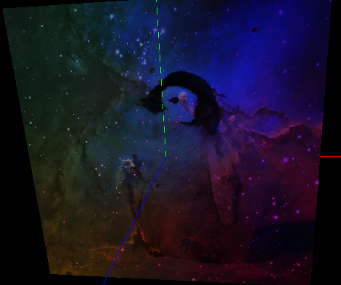
Trial 6
color = tex_landscape * tex_gradient * tex_penguin;

Slide 9
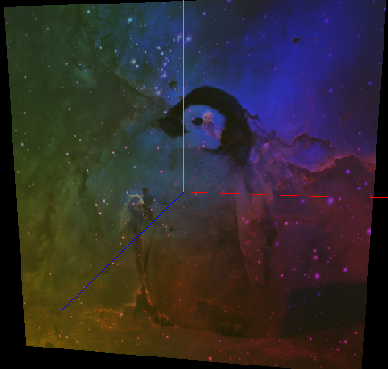
Trial 7
color =pass_Color*0.1 + tex_landscape * tex_gradient * tex_penguin;

Slide 10
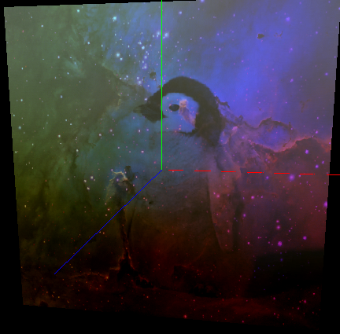
Trial 8
color =pass_Color*0.1 + tex_landscape * tex_gradient * tex_penguin +0.4* tex_gradient.b - 0.4*tex_gradient.r;

Slide 11
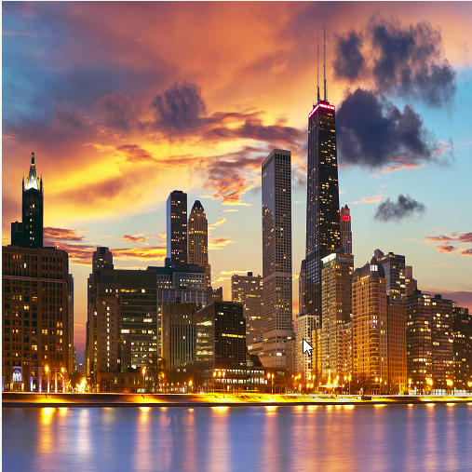
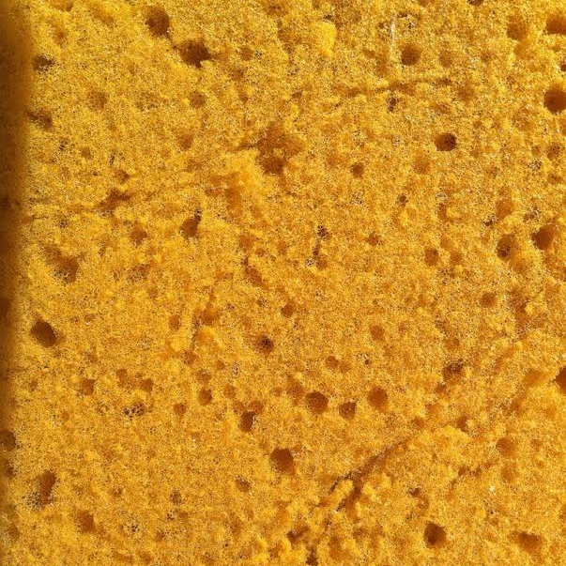
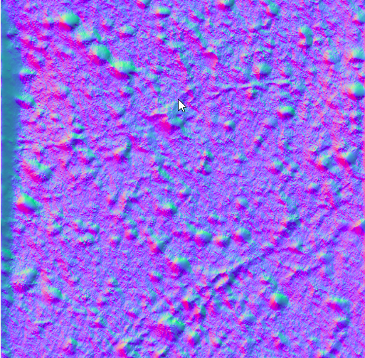
Problem 2
Landscape
Sponge
Noise map of Sponge

Slide 12
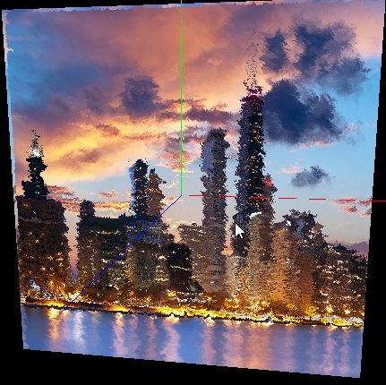
Trial 1
noiseVec = (noiseVec * 2.0 - 1.0) * 0.035;
Y-Z values

Slide 13
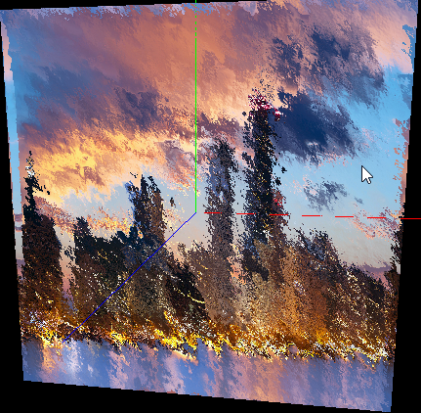
Trial 2
noiseVec = (noiseVec * 2.0 - 1.0) * 0.035;
X-Y values

Slide 14
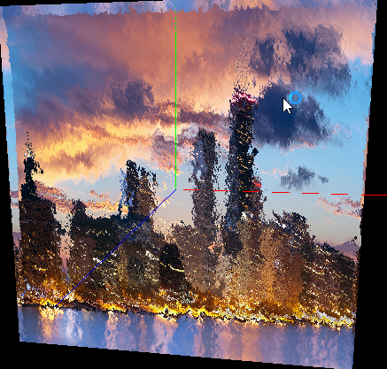
Trial 3
noiseVec = (noiseVec * 2.0 - 1.0) * 0.035;
X-Z values

Slide 15
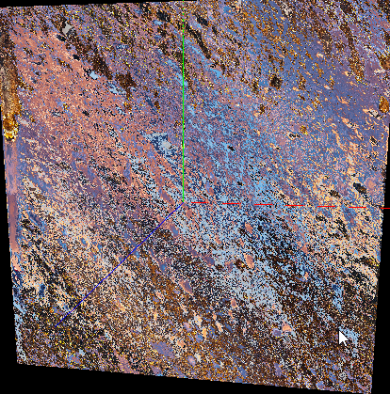
Trial 4
noiseVec = (noiseVec * 2.0 - 1.0) * 0.5;
X-Y values

Slide 16
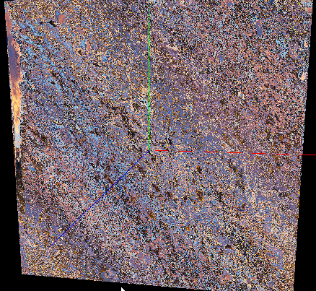
Trial 5
noiseVec = (noiseVec * 2.0 - 1.0) * 1;
X-Y values

Slide 17
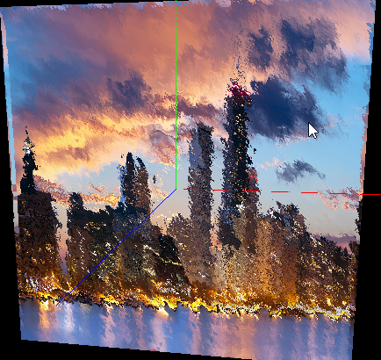
Trial 6
noiseVec = (noiseVec * 2.0 - 1.0) * 0.02;

Slide 18
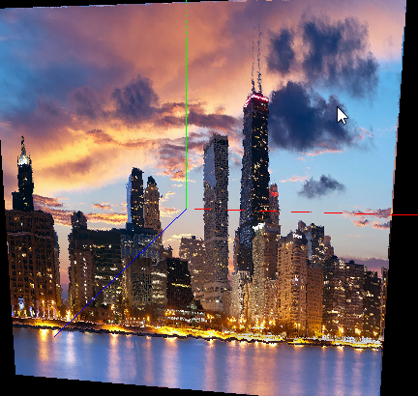
Trial 7
noiseVec = (noiseVec * 2.0 - 1.0) * 0.005;

Slide 19
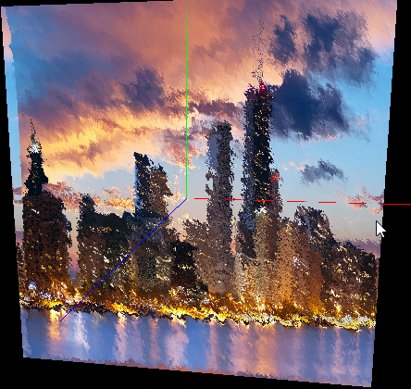
Trial 8
noiseVec = (noiseVec * 1.0 - 1.0) * 0.035;

Slide 20
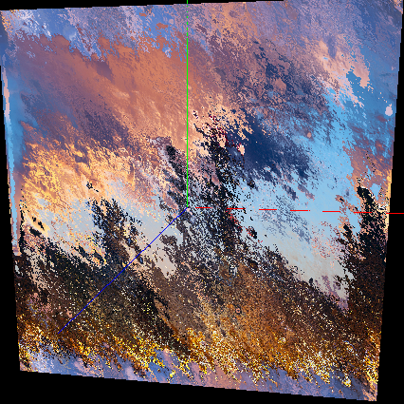
Trial 9
noiseVec = (noiseVec * 1.0 - 1.0) * 0.035;

Slide 21
Trial 10
noiseVec = (noiseVec * 5.0 - 1.0) * 0.035;

Slide 22
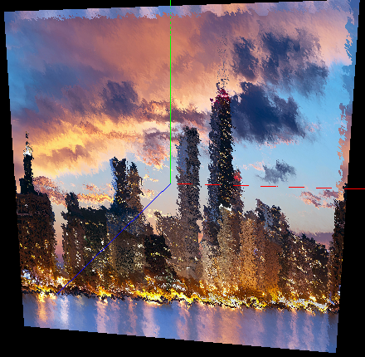
Trial 11
noiseVec = (noiseVec) * 0.035;

Slide 23
Questions?

